Slide 1
DUVAL CHAPTER

Slide 2
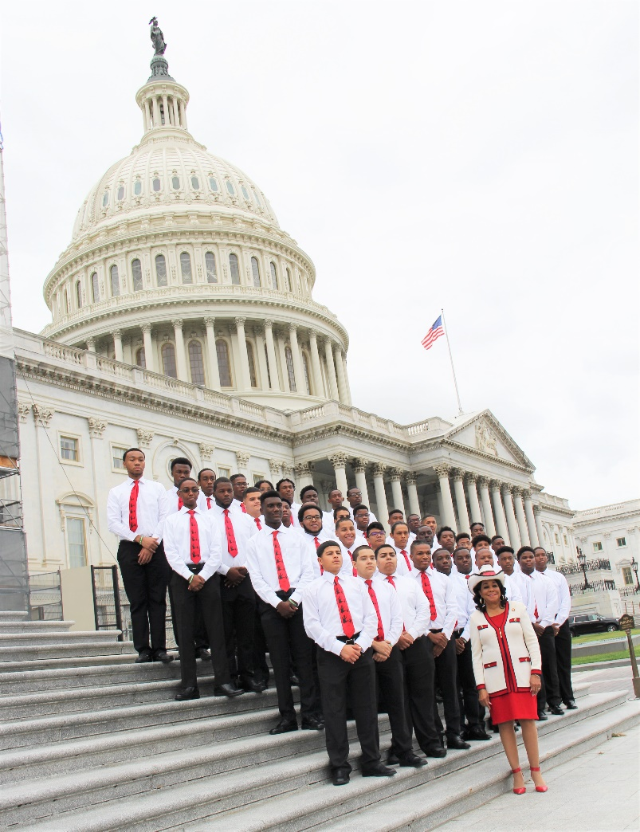
Historical Information
African-American Male Role Models of Excellence was initiated in Miami-Dade County in 1993 by then School Board Member Frederica S. Wilson to address and end the pattern of minority boys being incarcerated, entering the drug trade, or dropping out of school at disproportionately high rates.
In 1994, as a response to the increased enrollment of mentors and students, the name was converted to the 5000 Role Models of Excellence Project.
The 5000 Role Models of Excellence Project launched in Duval County in 2015.
Current chapters include Miami-Dade County, Duval County, Pinellas County, Broward County & Detroit Michigan.

Slide 3
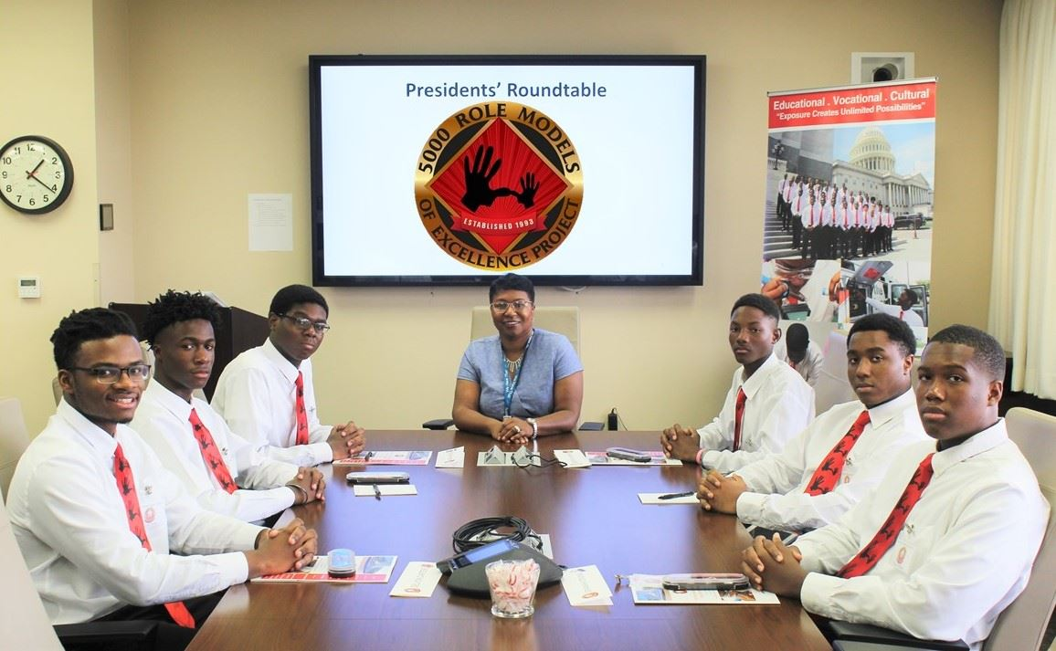
Mission
The 5000 Role Models of Excellence Project seeks to provide a sense of hope to young minority male students by offering positive visions of success to serve as a blueprint for emulation through mentorship and exposure. The 5000 Role Models of Excellence Project is committed to connecting students of promise to positive adult role models whose successes can inspire them to achieve.

Slide 4
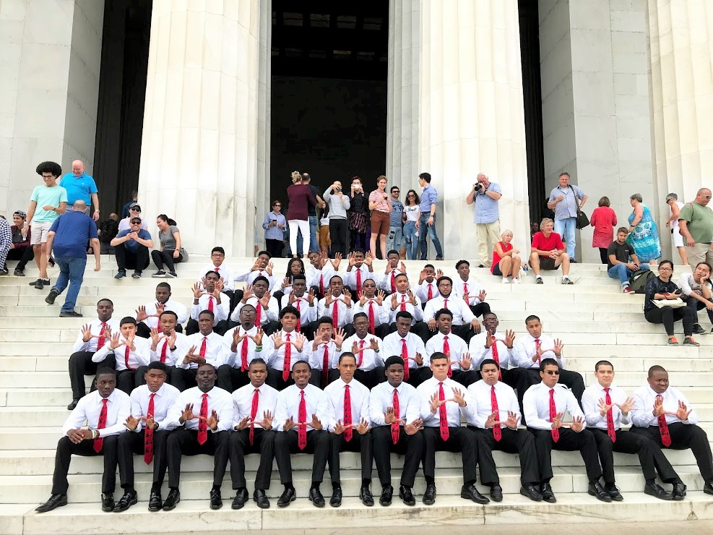
Key Program Components
Weekly Meetings with Site Directors
Mentoring
Leadership Development
Career Exploration & Job Shadowing
Cultural Exposure
College Tours
All Field Trips are Virtual During the Covid-19 Pandemic.

Slide 5
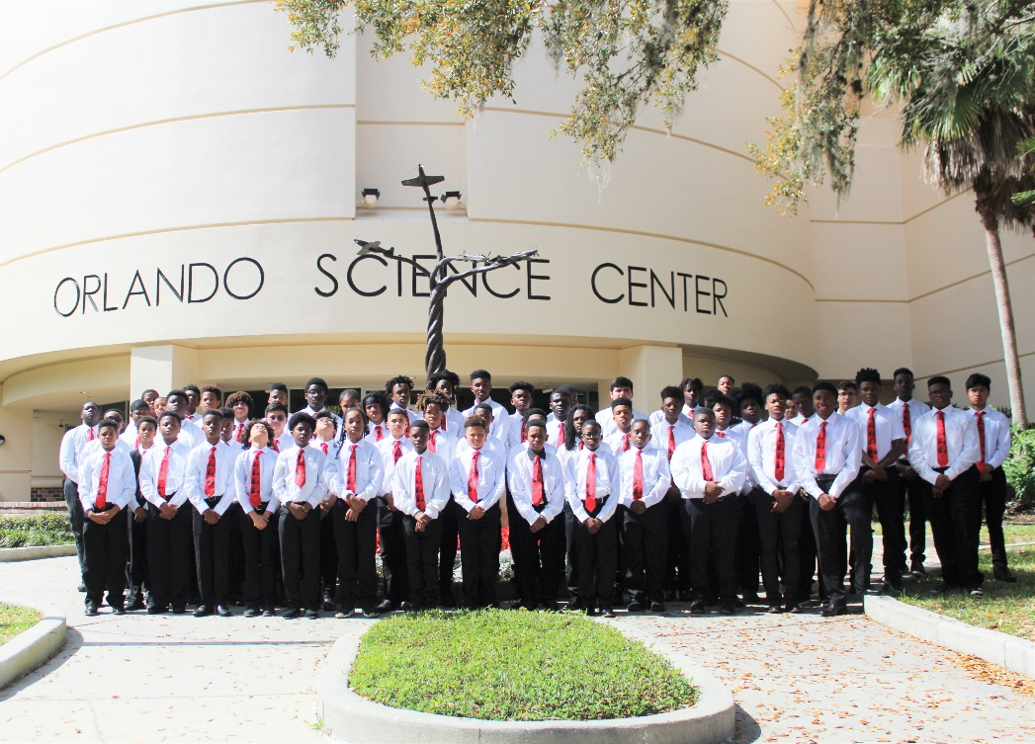
Selection Process for Students
A student should be a minority male (not exclusive) at a participating 5000 RMOE School. Students must complete the Application and submit a Parent Consent Form. Students must be willing to attend weekly meetings and attend project events. To be deemed eligible a student must meet at least two of the qualifying factors listed below.
Criteria:
The student needs a positive male role model in their life;
The student has exhibited leadership skills that need to be developed;
The student is eligible for free or reduced lunch;
The student has a record of involvement with a social service system;
A member of the immediate family has been incarcerated (or member of the household);
The head of household is a single parent;
The head of household is not a custodial parent;
A teacher, counselor, social worker, or community-based service organization recommends the student.
Additional factors for eligibility may be considered upon the discretion of an administrator

Slide 6
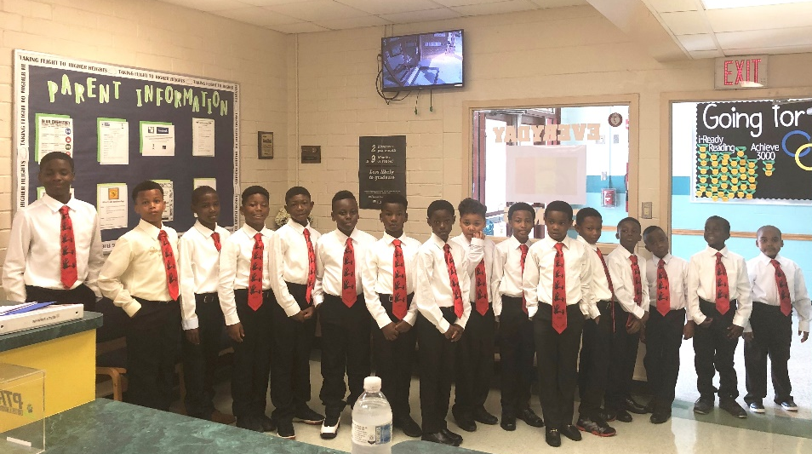
Participating Schools
Membership Data as of January 2021
HIGH
MIDDLE
ELEMENTARY
First Coast (61)
Robert E. Lee (20)
Terry Parker (8)
William M. Raines (14)
Jean Ribault (38)
Westside (17)
Edward H. White (12)
Samuel W. Wolfson (18)
Arlington Middle (11)
Jefferson Davis (14)
Alfred I. DuPont (8)
Highlands (18)
Twin Lakes Academy (8)
Jean Ribault (13)
Joseph Stilwell (20)
J.E.B. Stuart (28)
Northwestern Legends (12)
Rev 8/21/2015

Slide 7
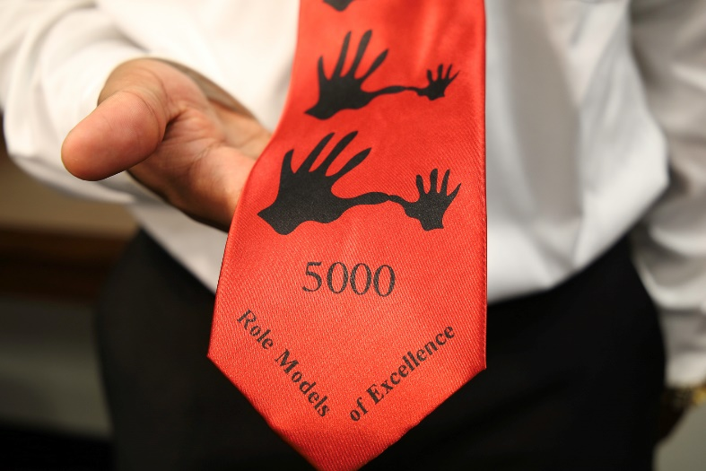
UNIFORM & SIGNATURE NECKTIE
The young men wear white, long-sleeved dress shirts, black dress pants, black dress shoes & socks with signature neckties. The ties are red, representing power and are imprinted with the 5000 Role Models of Excellence Project logo (a small hand, representing the “role model mentee” next to a large hand, representing the positive adult “role model mentor.”) The hands are connected to symbolize how working together can build a bridge that will help carry a heavy load.

Slide 8
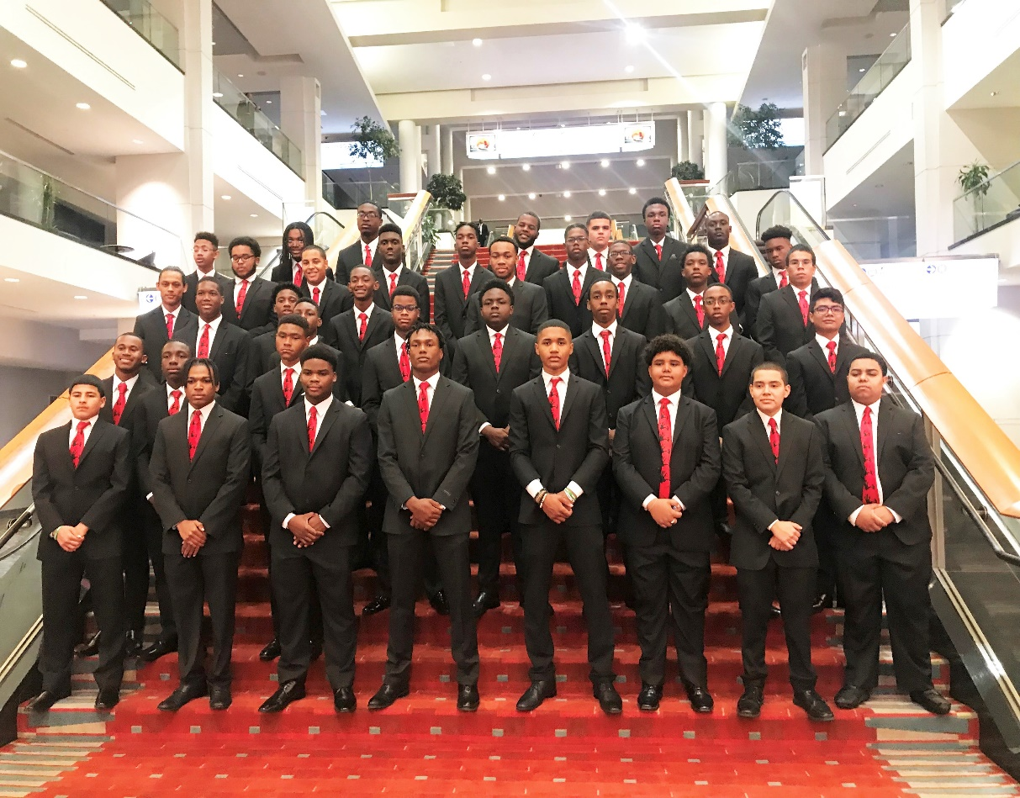
AMBASSADORS
Students in the program participate in school and community-based events through the Ambassadors Program.
Their duties include:
Assist in logistical development and preparation of special school events.
Serve as usher to escort guests from parking lot destination.
Serve as official greeters/messengers with a special mission representing the Role Model Project. Ambassadors are courteous and polite thus providing students with opportunities for positive exposure throughout the community.

Slide 9
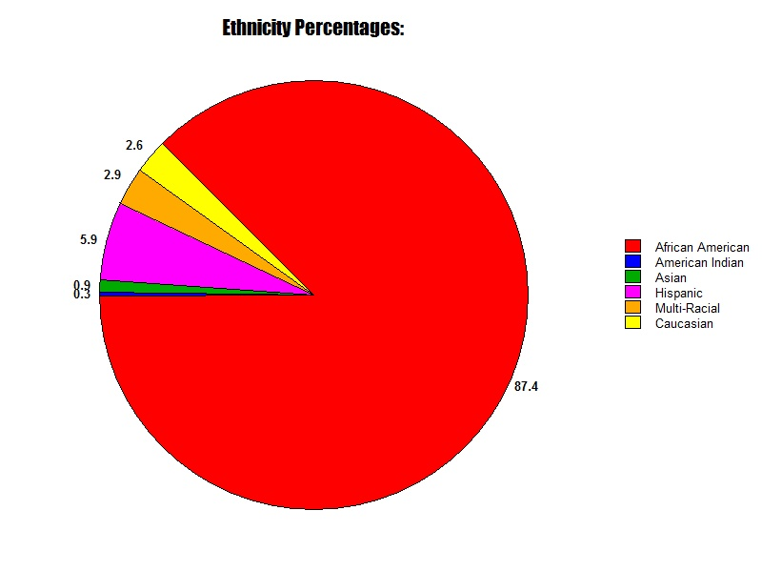
Ethnicity
Data Based on the 2019-2020 School Year
87.4% - African American
5.9% - Hispanic
2.9% - Multi-Racial
2.6% - Caucasian
0.9% - Asian
0.3% - American Indian

Slide 10
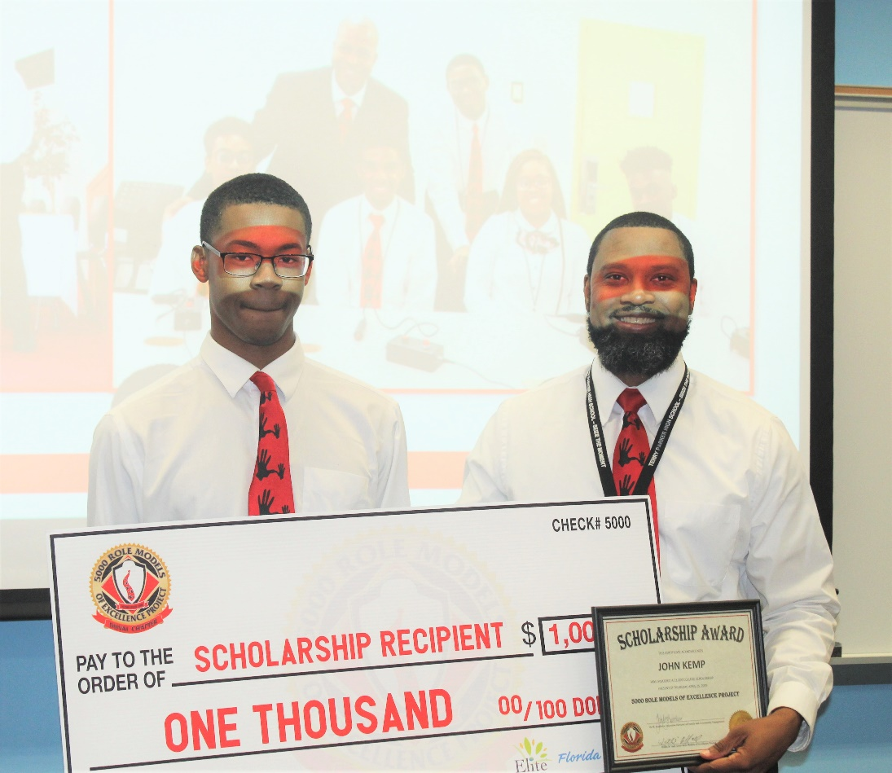
SUCCESSES
Data Based on the 2019-2020 School Year
74% of members had an increase in overall grade point average.
81% of members had a decrease in or had no behavioral referrals.
96% of members were promoted to the next grade level.
Six graduating seniors of the class of 2020 received a $1,000 transitional college scholarship.

